Slide 1
Lecture # 8
CSC336 Web Technologies
Credit Hours: 3(2, 1)

Slide 2
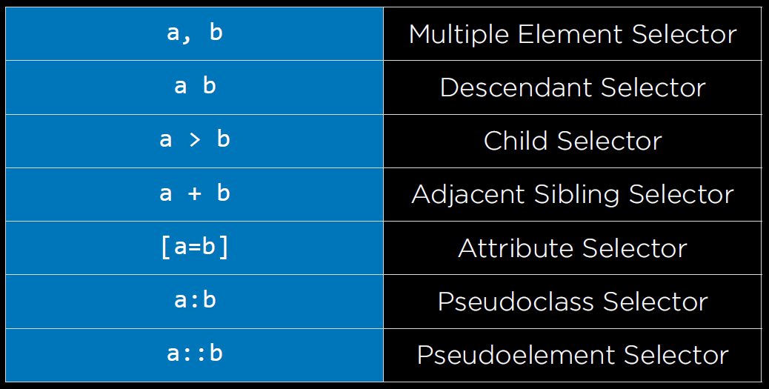
CSS Selectors

Slide 3
descendantSelector.html
li {
color: blue;
}
<ol>
<li>list item one.</li>
<li>list item two.</li>
<ul>
<li>sublist item a.</li>
<li>sublist item b.</li>
</ul>
<li>list item three.</li>
</ol>
Descendant (Child + Grandchild) Selector
ol li {
color: blue;
}
(immediate)Child Selector
ol>li {
color: blue;
}

Slide 4
attributeSelector.html
<ul>
<li><a href="https://google.com">Google</a></li>
<li><a href="https://facebook.com">Facebook</a></li>
<li><a href="https://amazon.com">Amazon</a></li>
</ul>
a{
color:green;
}
a[href="https://facebook.com"]{ color:blue;
}

Slide 5
pseudoclassSelector.html
<button>Click Me!</button>
button {
background-color: green; font-size: 24px;
width: 200px; height: 50px;
}
button:hover{
background-color: orange;
}

Slide 6
CSS Pseudo Elements
Selector | Example | Example description
::after | h1::after | Insert something after the content of each <h1> element
::before | h1::before | Insert something before the content of each <h1> element
::first-letter | p::first-letter | Selects the first letter of each <p> element
::first-line | p::first-line | Selects the first line of each <p> element
::marker | ::marker | Selects the markers of list items
::selection | p::selection | Selects the portion of an element that is selected by a user

Slide 7
Q & A

